Slide 1
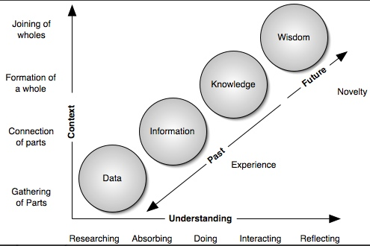
Data v/s Information
Data is unorganised raw fact that need processing without which it is seemingly random and useless to humans.
Information is a processed, organised data presented in a given context and is useful to humans.
Acquisition of information and facts is called Knowledge. Knowledge is awareness and understanding of facts.
Understanding and application of knowledge is called wisdom. Wisdom is Knowing what to know, how much and what to do with it.

Slide 2
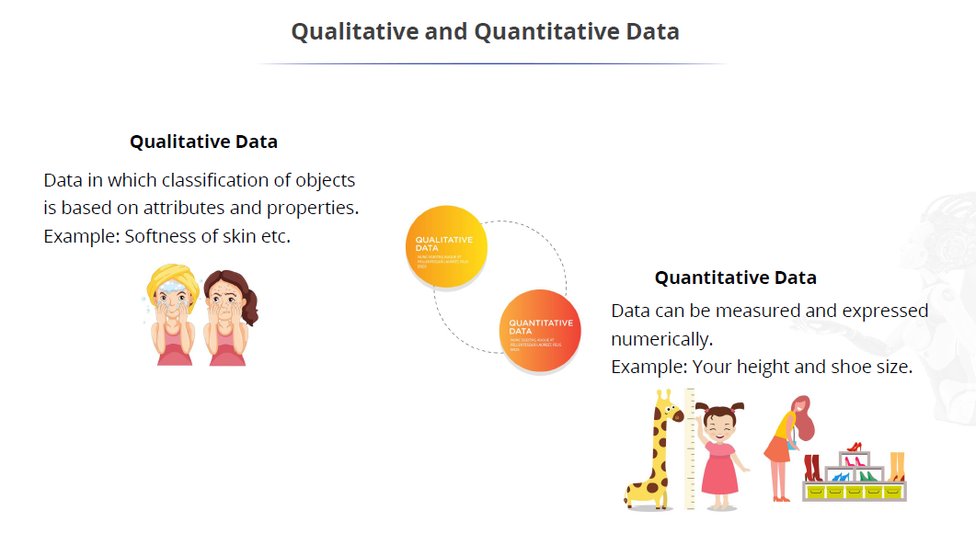
Nature of Data

Slide 3
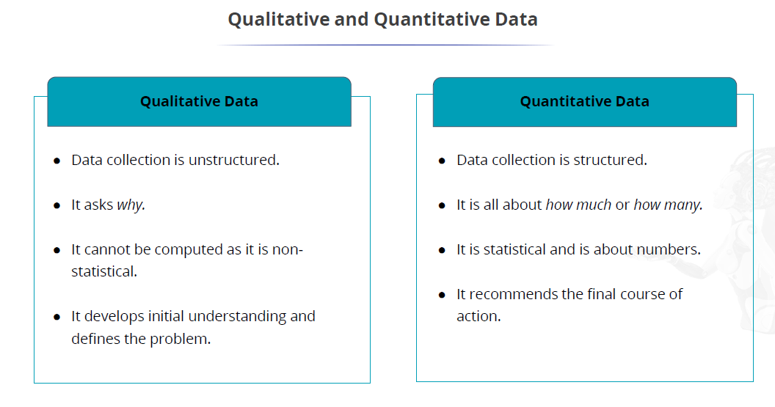
Nature of Data

Slide 4
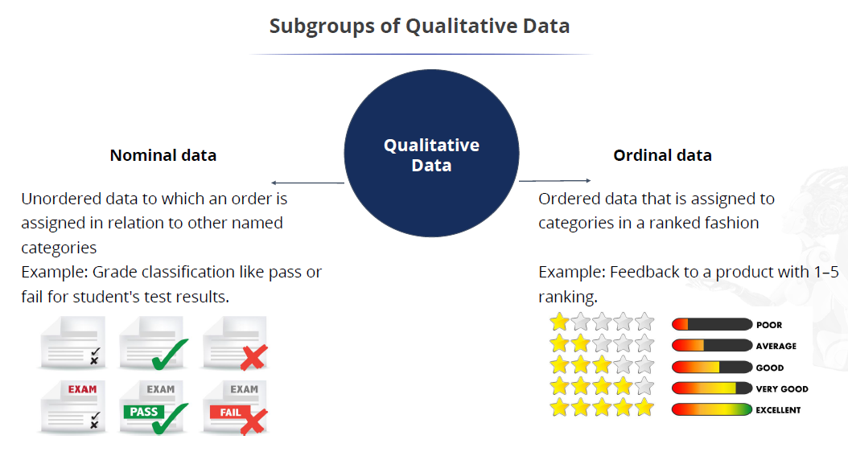
Nature of Data – Qualitative Data

Slide 5
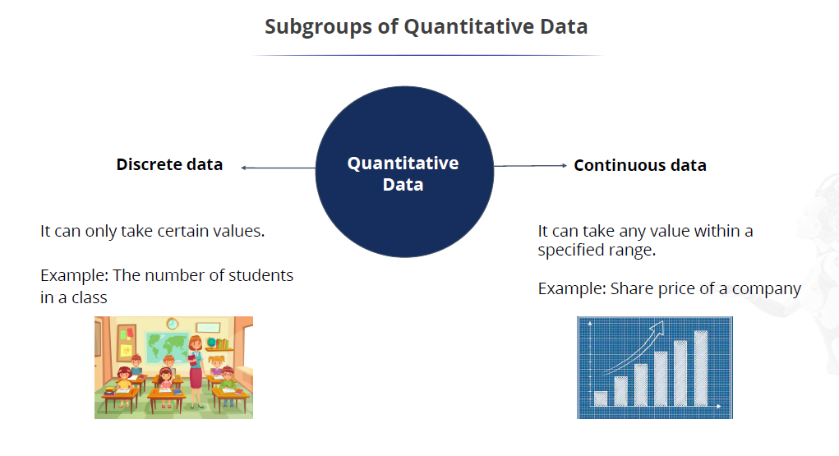
Nature of Data – Quantitative Data

Slide 6
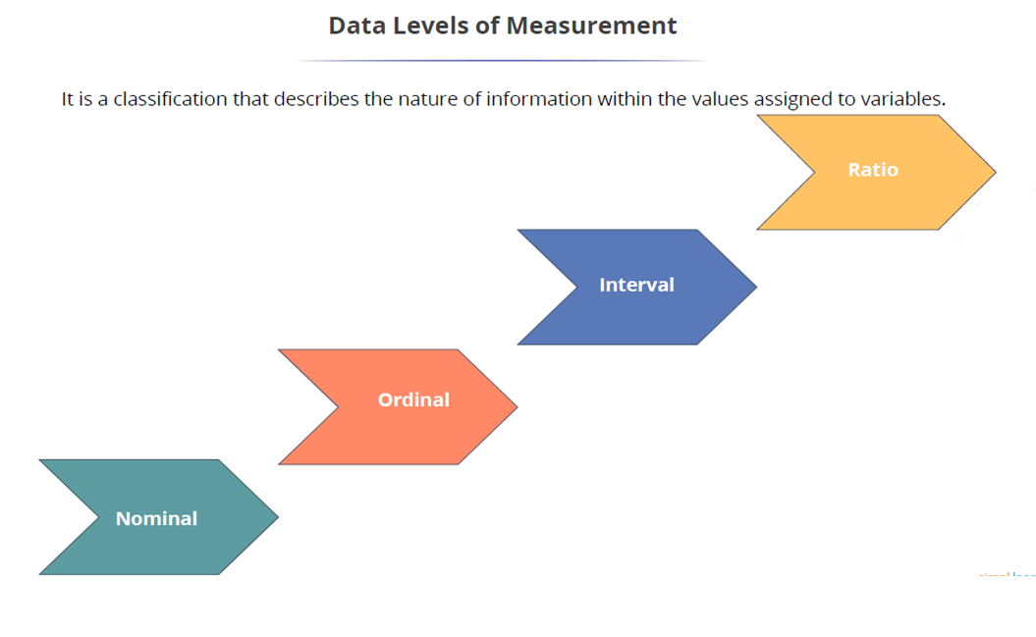
Levels of Measurements

Slide 7
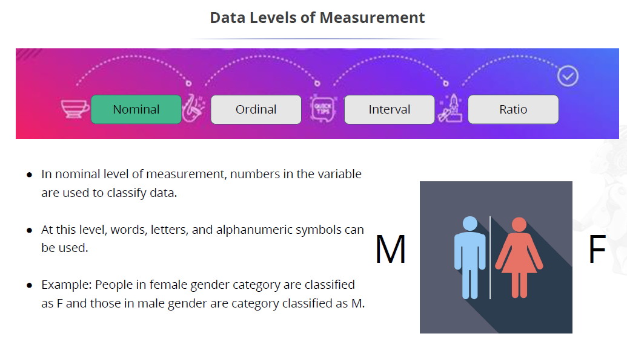
Levels of Measurements

Slide 8
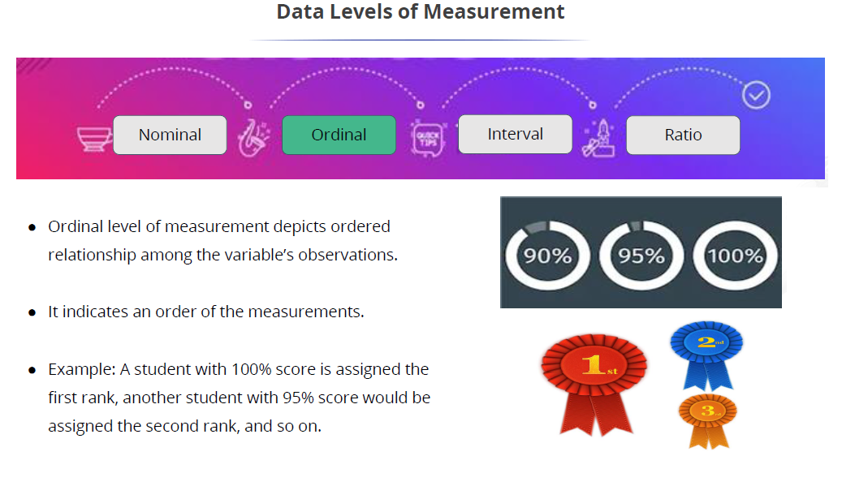
Levels of Measurements

Slide 9
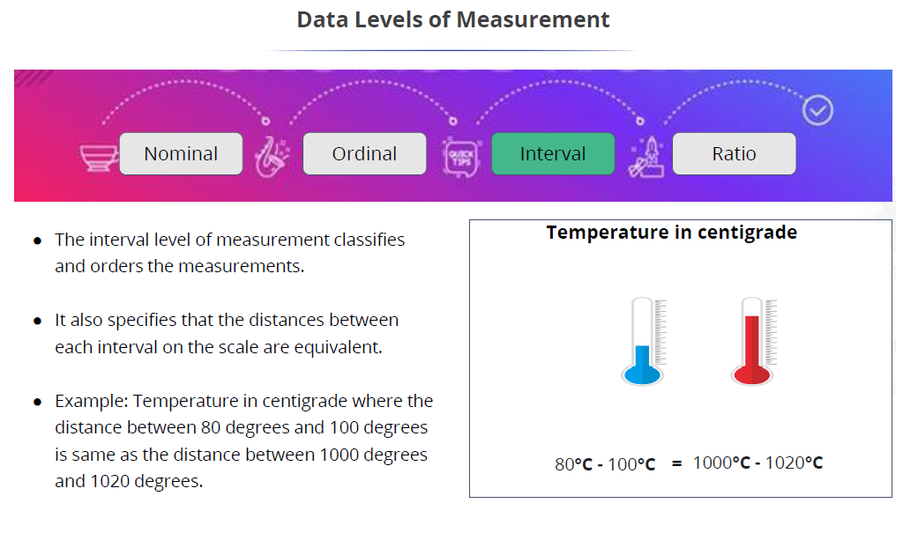
Levels of Measurements

Slide 10
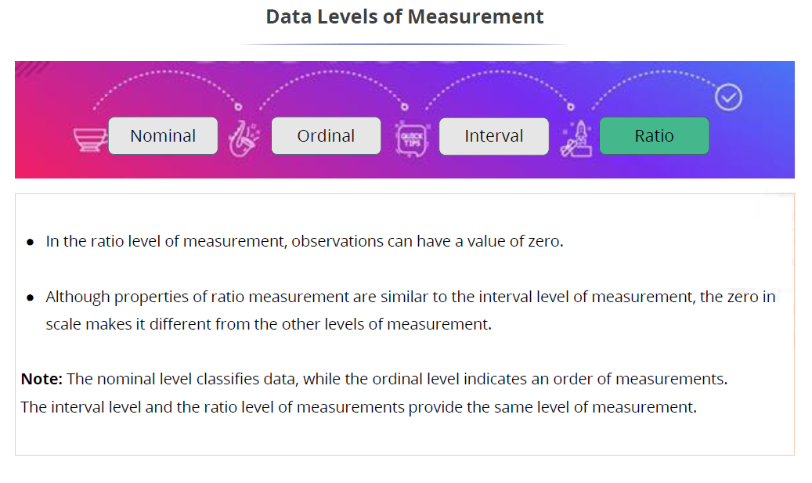
Levels of Measurements

Slide 11
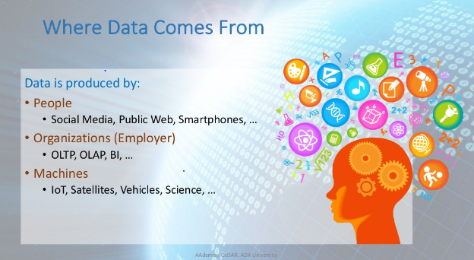
Sources Of Data
Three Major Sources of Data are:
People
Organizations
Machines

Slide 12

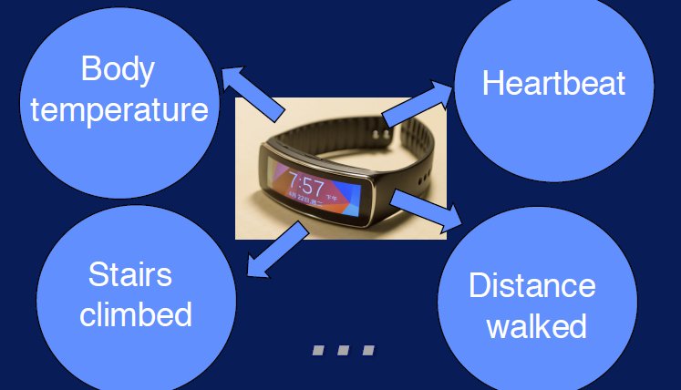
Data Sources - Machine Generated Data

Slide 13
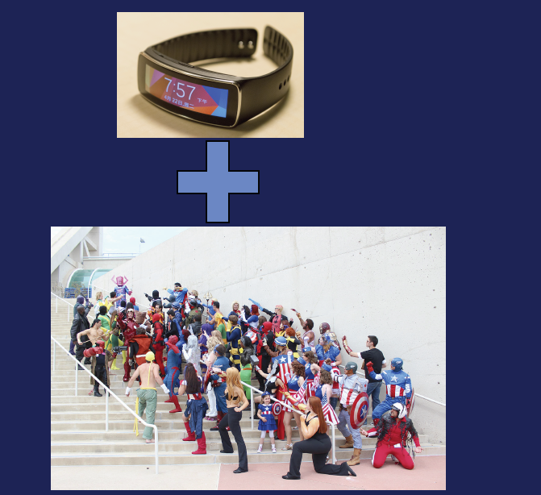
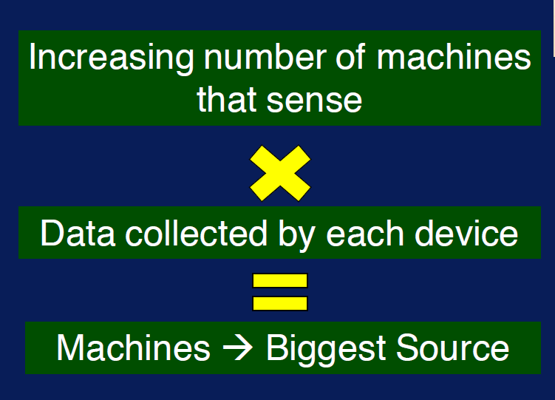
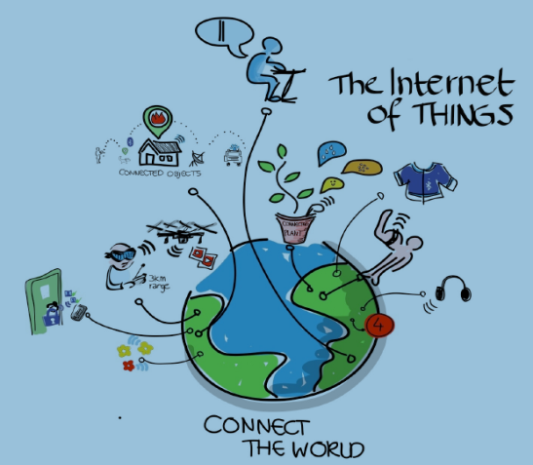
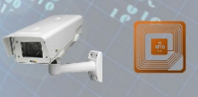

Data Sources - Machine Generated Data

Slide 14
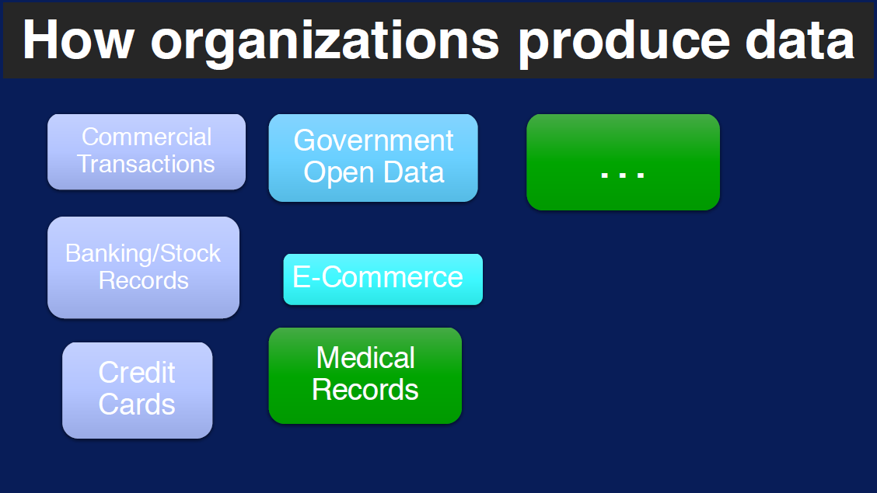
Data Sources - Organizations

Slide 15
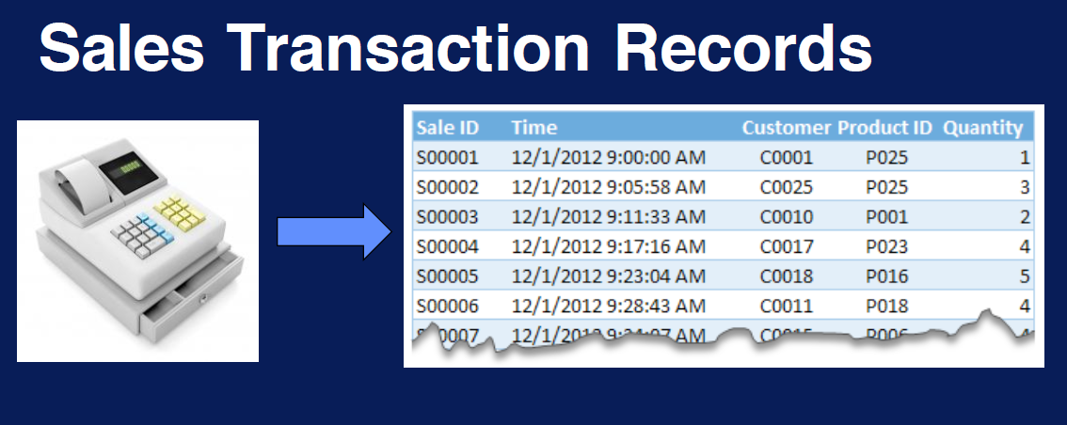
Data Sources - Organizations
Note: Mostly data generated by organizations is structured i.e. organizations are major source of structured data.

Slide 16
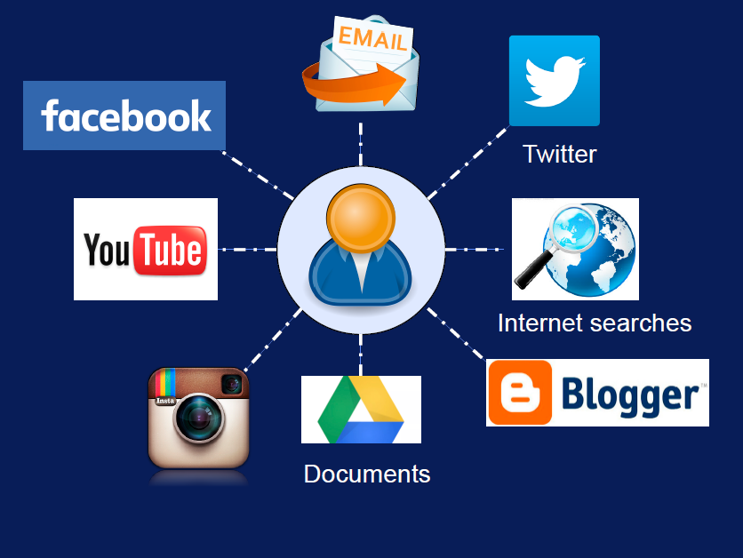
Data Sources - People
Note: Human beings are the major source of unstructured data.

Slide 17
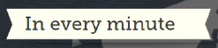
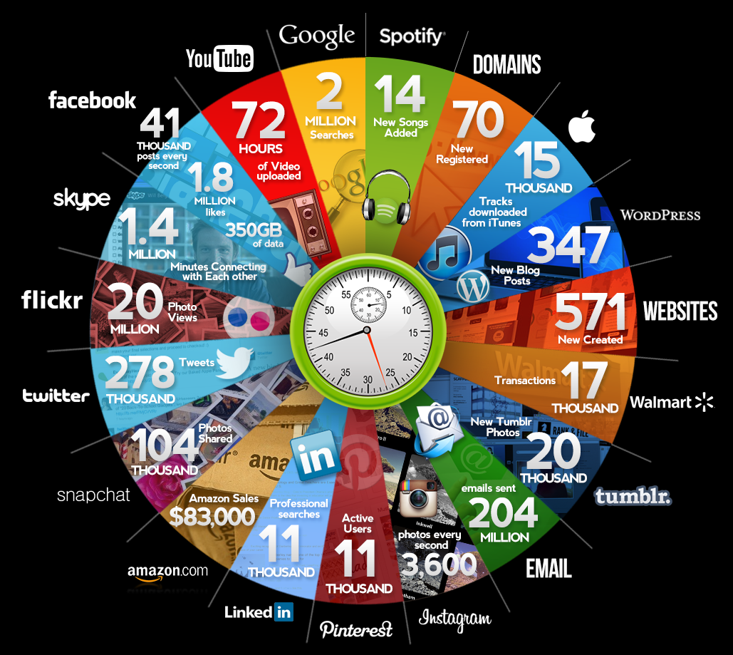
Data Sources - People

Slide 18
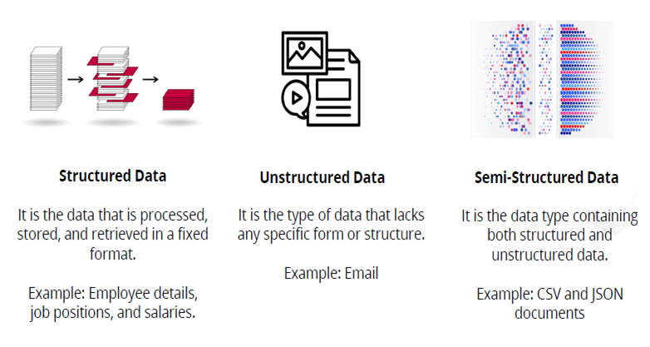
Classification of Data
Structured Data
Unstructured Data
Semi Structured Data

Slide 19
Structured Data
Structured data is the data which conforms to a data model, has a well define structure, follows a consistent order and can be easily accessed and used by a person or a computer program.
SQL (Structured Query language) is often used to manage structured data stored in databases.
Characteristics of Structured Data:
Data conforms to a data model and has easily identifiable structure.
Data is stored in the form of rows and columns.
Sources of Structured Data
SQL Databases
Spreadsheets such as Excel
OLTP Systems
Online forms
Sensors such as GPS or RFID tags
Network and Web server logs
Medical devices

Slide 20
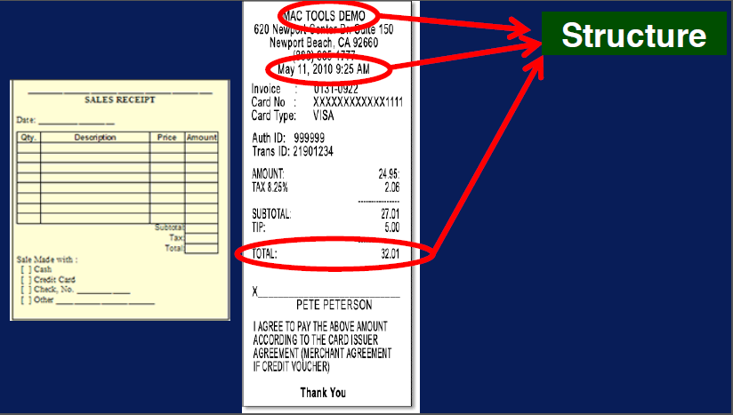
Structured Data - Example

Slide 21
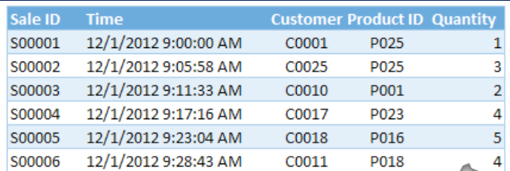
Structured Data - Example
Sales Data – Sale Id, Time ,Customer Id, Product Id, Quantity etc.
Meta Data – Time and date of creation of file, Author Name, file size etc.
Census Record – Birth date, income, employment, location etc.

Slide 22
Unstructured Data
Unstructured data is the data which does not conforms to a data model and has no easily identifiable structure such that it can not be used by a computer program easily, thus it is not a good fit for a mainstream relational database.
Characteristics of Unstructured Data:
Data neither conforms to a data model nor has any structure.
Data can not be stored in the form of rows and columns as in Databases
Data does not follows any semantic or rules
Data lacks any particular format or sequence
Data has no easily identifiable structure
Sources of Unstructured Data:
Web pages
Images (JPEG, GIF, PNG, etc.)
Videos
Reports
Word documents and PowerPoint presentations
Surveys

Slide 23
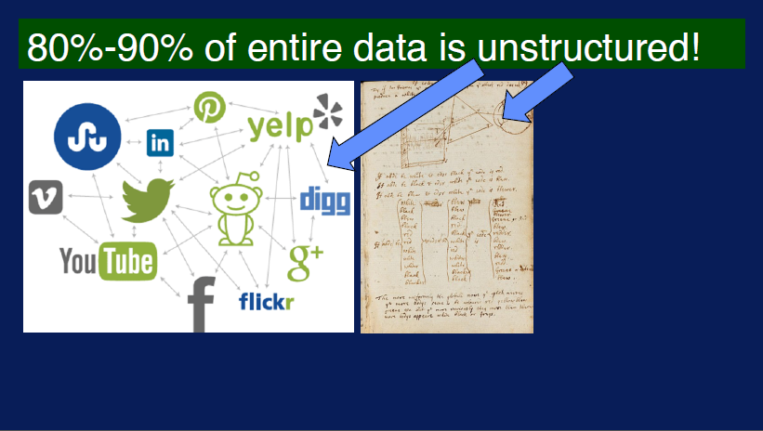
Unstructured Data - Example

Slide 24
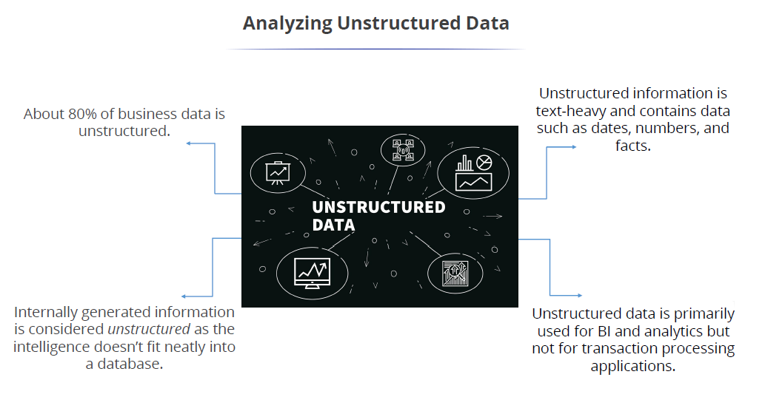
Unstructured Data

Slide 25
Semi structured Data
Semi-structured data is the data which does not conforms to a data model but has some structure.
It lacks a fixed or rigid schema. It is the data that does not reside in a rational database but that have some organisational properties that make it easier to analyse.
With some process, we can store them in the relational database.
Characteristics of semi-structured Data:
Data can not be stored in the form of rows and columns as in Databases
Semi-structured data contains tags and elements (Metadata) which is used to group data and describe how the data is stored
Similar entities are grouped together and organised in a hierarchy
Entities in the same group may or may not have the same attributes or properties
Does not contains sufficient metadata which makes automation and management of data difficult
Size and type of the same attributes in a group may differ
Sources of semi-structured Data:
XML and other markup languages
Binary executables
TCP/IP packets
Zipped files
Web pages

Slide 26
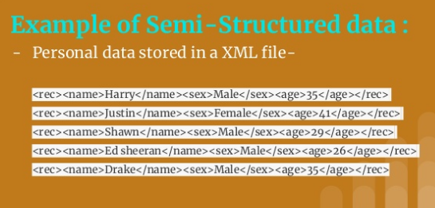
Semi Structured Data

Slide 27
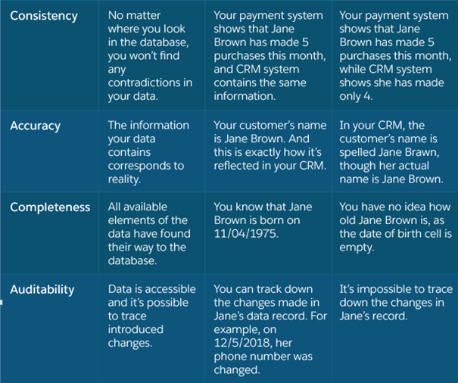
Characteristics of Data

Slide 28
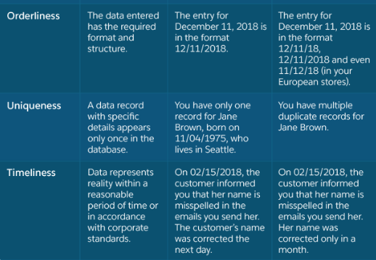
Characteristics of Data

